Slide 1
Modeling the Topic: Resilient Basing
Olin Kennedy, MAJ, USA
Ian MacDonald, Capt, USAF
Tyler Lucas, 1st Lt, USAF
Alex King, 2d Lt, USAF

Slide 2
Factors of the Resilient Basing
Desired Outcome: Aircraft Available after Missile Attack for Retaliation Missions
Actions: Ability to affect the quantity represented in each box
Cost: Applies to potential actions
Logistics Capacity
Pre-positioned Stocks
Modified by Posture
Presumed level of Throughput
Posture
How many “activated bases” available
Enabled by Training
Base Defenses
Aircraft Dispersion On-Base (Passive)
Hardened Infrastructure (Passive)
ADA Point-Defense (Active)

Slide 3
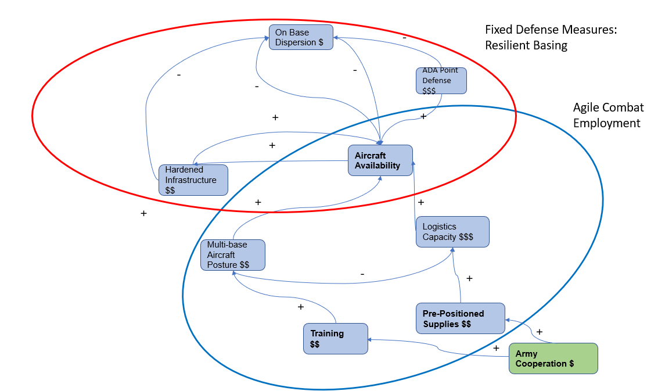
Causal Diagram
Theatre-Level Resolution
X number of Aircraft are located in INDO-PACOM
Chinese launch a Surprise LRPM strike of Y missiles
Goal: Have some level Z aircraft available after the strike
Level Z of aircraft influenced by the factors on the causal diagram

Slide 4
Literature and (Data)
Air Base Defense: Rethinking Army and Airforce Roles and Functions. RAND Corporation (2020).
Use current joint cruise missile defense policy to bolster USAF defenses (# missiles).
Convince Army leadership to shore gaps in USAF measures (SMEs/outreach).
Use innovative technology as developed by Army service (survey of assets and effectiveness)
Harden structures across bases in the forward theater (# and cost)
Operational Imperative: Investing Wisely to Bolster US Air Bases Against Chinese and Russian Attacks. RAND Corporation (2023).
Dispersion is low cost and effective (land area available)
Passive defenses are less expensive than active defense measures ($ and #)
Develop redundant logistics systems (current supply chain sys)

Slide 5
Recommendations
Recommend a Follow-on Study to develop a concept where Air Force and Army jointly support the agile combat employment concept. Concept can be tested using Simulation.
Data Sources: Requires SMEs from Air Force and Army to build the concept. SMEs: Logisticians, Aviators, Signal Support from both services. Challenge is getting different services to work together. Different Systems, Different Cultures.
Major Criteria:
Decrease in Training Required (of AF personnel) because Army Personnel fill the gap
Increase in Capability to Preposition Supplies because Army can secure the site and supplies.
Where might this capability from the Army come from?
Army has more than 10 Combat Aviation Brigades which consist of logisticians, cargo helicopters, Air Traffic Controllers, Comms Personnel. Army Helicopters don’t have the range to be generally useful so these individuals would otherwise be under-employed.

Slide 6
References
Air Force Doctrine Note 1-21: Agile Combat Employment (23 Aug 22) Department of the Air Force Operational Imperative-5 (12 Sept 22)
Operational Imperative: Investing Wisely to Bolster US Air Bases Against Chinese and Russian Attacks. RAND Corporation (2023)
New Directions for Projecting Land Power in the Indo-Pacific: Contexts, Constraints, and Concepts. RAND Corporation (2022)
Air Base Defense: Rethinking Army and Airforce Roles and Functions. RAND Corporation (2020)
Arrol, Matthew, (2022) “The Key to Maximizing the Air Force’s Agile Combat Employment Concept? The Army” Modern War Institute at West Point.

Slide 7
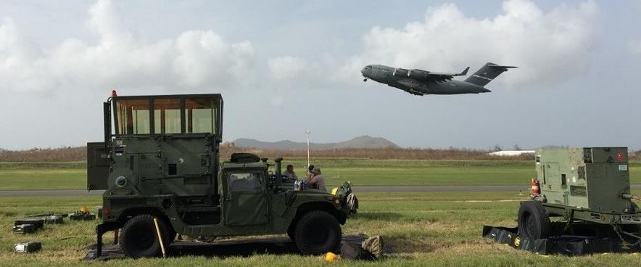
Questions?
Notes:
How the stakeholders view the problem
What is ACE
How have we executed this?
Then current literature

